Slide 1


Slide 2
01
BACKGROUND
02
OBJECTIVE
03
DATA EXPLORATION
content
04
SENTIMENT ANALYSIS
05
WORDCLOUD
06
TOPIC MODELING
07
SUGGESTIONS

Slide 3
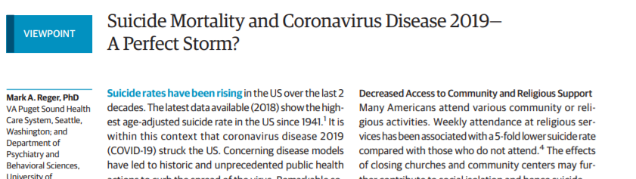

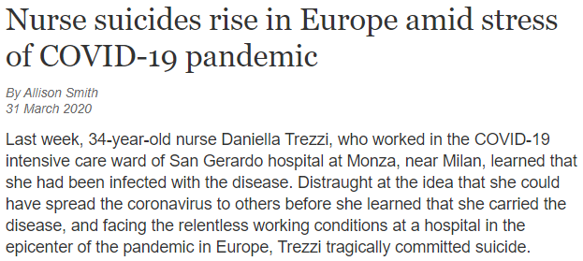
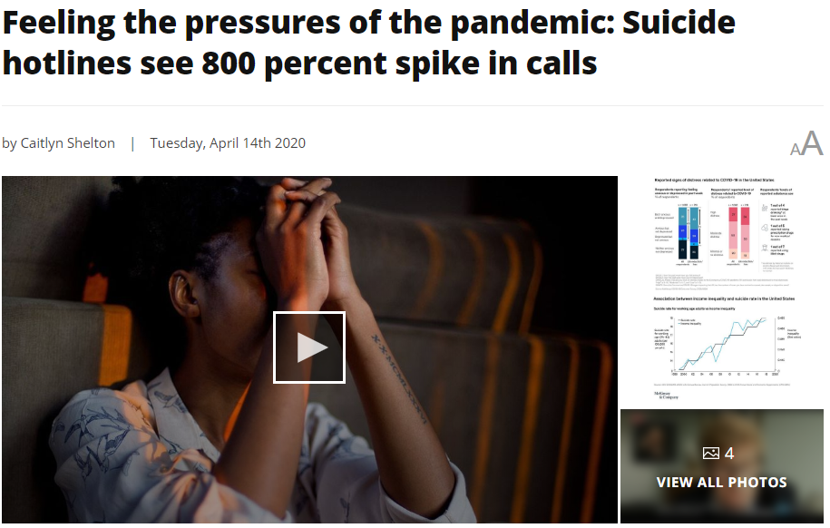
BACKGROUND
Notes:
In a new report in the Journal of the American Medical Association, researchers warned that the social distancing measures that have been credited with reducing the spread of the virus were also fueling the factors that often drive people to suicide. Also, there is also news about suicide, including suicide hotlines see a surprising increase in spike and a nurse in Europe committed suicide.
Forcing people at home can make people feel frustrated. It may be caused by people feeling bored or just panic watching the number of confirmed cases going up. We want to know what kinds of topic on Twitter can make people feel better and what kinds of topic do not, so we can make guidance to people.
In general, right now we focus more on people’s physical health, but will sometimes ignore mental health.
Thus, we’d like to pay attention to people’s mental condition. This is achieved by Twitter analysis.

Slide 4
OBJECTIVE
Our objective is to ensure people’s mental health in the special COVID-19 pandemic.
Our data source is Tweets with the hashtag of #StayHome on Twitter and our main analysis method is to understand the emotions of people and identify possible factors (eg. topics or activities) that influence their emotions with NLP tools (sentiment analysis, word clouds, and topic modeling)
We will give detailed suggestions to people who feel mental discomfort during the quarantine period.
Notes:
Our objective is to ensure people’s mental health in the special COVID-19 pandemic.
Our data source is Tweets with the hashtag of #StayHome on Twitter and our main analysis method is to understand the emotions of people and identify possible factors (eg. topics or activities) that influence their emotions with NLP tools (sentiment analysis, word clouds, and topic modeling)
We will give detailed suggestions to people who feel mental discomfort during the quarantine period.

Slide 5

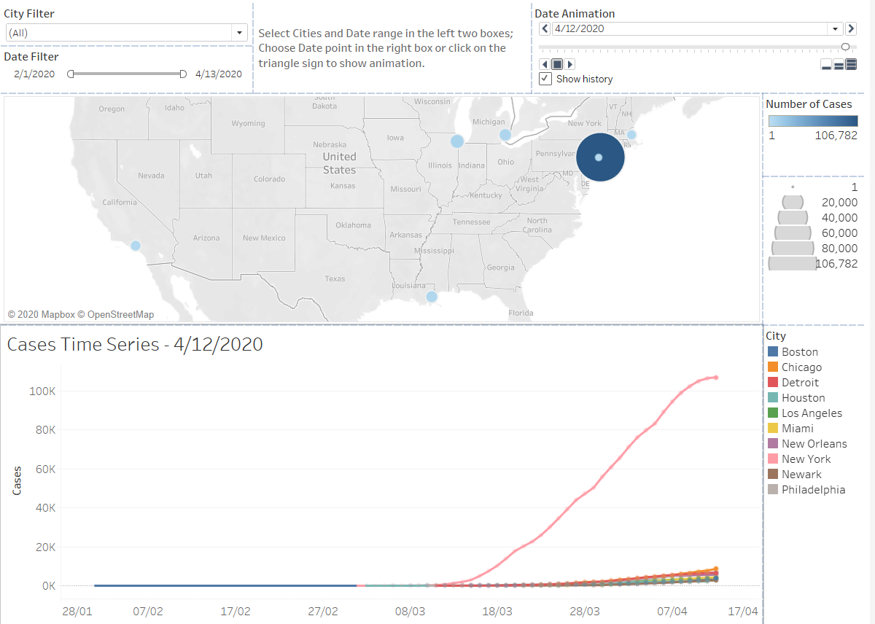
DATA EXPLORATION
Notes:
Based on the number of confirmed cases and population level, we selected 10 big cities as targets. People in these cities are more likely to suffer from mental problem because of the severe situation.
The 10 cities are New York City, Boston, Chicago, Detroit, Los Angeles, Houston, Newark, Miami, Philadelphia and New Orleans.
Plot in this slide shows the increase of confirmed cases in these 10 cities. As we can see, cases in these cities is increasing faster, especially New York.
Then we used python to scrape tweets of users who live in these cities. In particular, we look at the hashtag ‘#StayHome’, which is related to social distancing, one of the most effective methods to stop virus from spreading. We got data between 2020-03-05 and 2020-04-11.

Slide 6
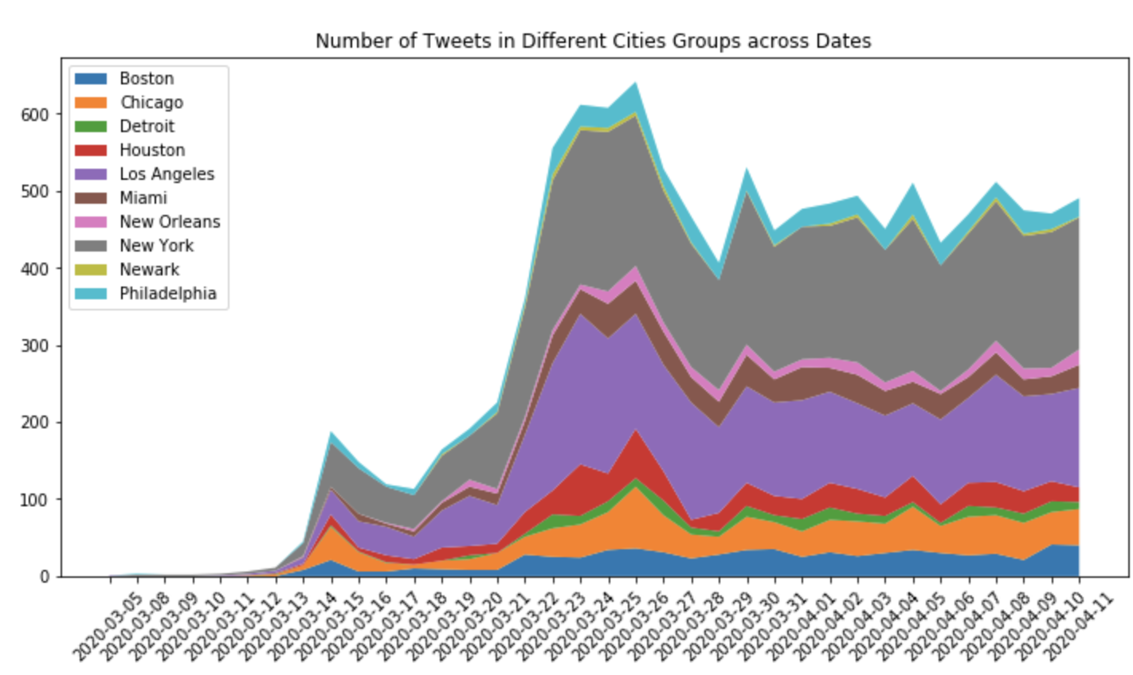
DATA EXPLORATION
Notes:
This plot shows the number of tweets in different cities. It’s easy to notice that, for most cities, there is a sudden increase of tweets number around late March. This is caused by the shelter in place announcement. For example, New York announced this order on 03-22. A blue line is drawn in the plot to refer to this date. And we can find an obvious increase around this date. This means that the shelter in place announce increased people’s awareness and attention of COVID-19, so people started to attach great importance to ‘StayHome’ and talked about it more.
And after several days, number of tweets decreased, which indicates that people started to pay less attention to that and they have get accustomed to staying at home.

Slide 7

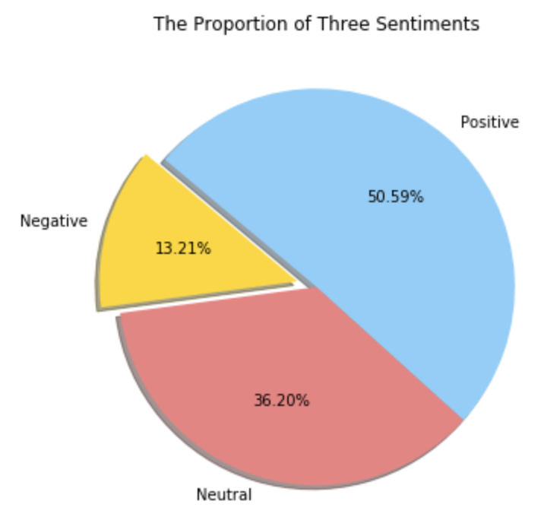
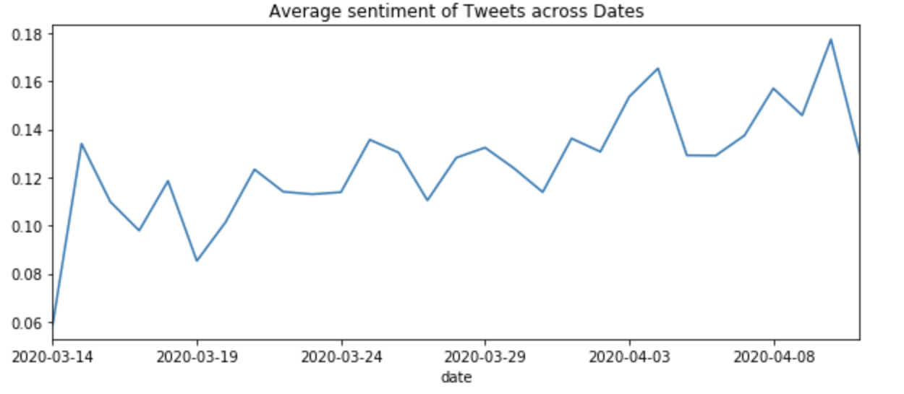
SENTIMENT ANALYSIS
Notes:
Sentiment Analysis:
Based on users’ tweets, we applied sentiment analysis with TextBlob by calculating the polarity. Then based on polarity, users were divided into 3 categories. If polarity is larger than 0, we considered it as positive. If smaller than 0, it’s negative. If equal to 0, it’s neutral.
Result:
According to the pie chart, more than half tweets are still positive, and only 13% tweets are negative.
And look at the plot of time series, we can learn that in general sentiment of people becomes more and more positive as time goes by.

Slide 8
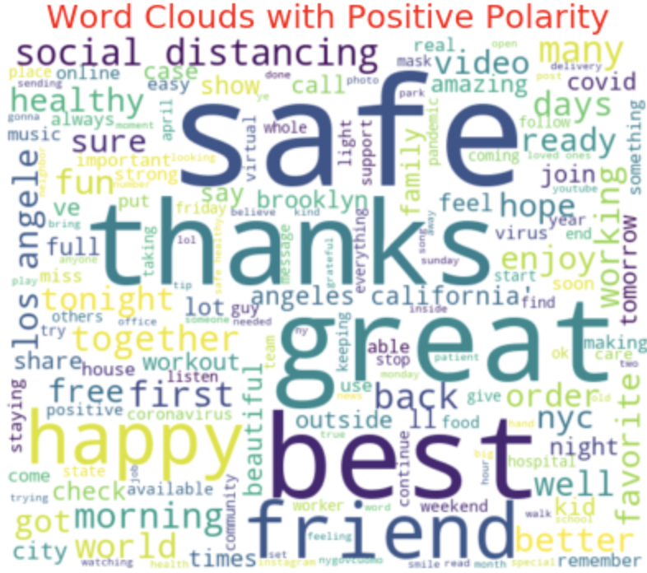
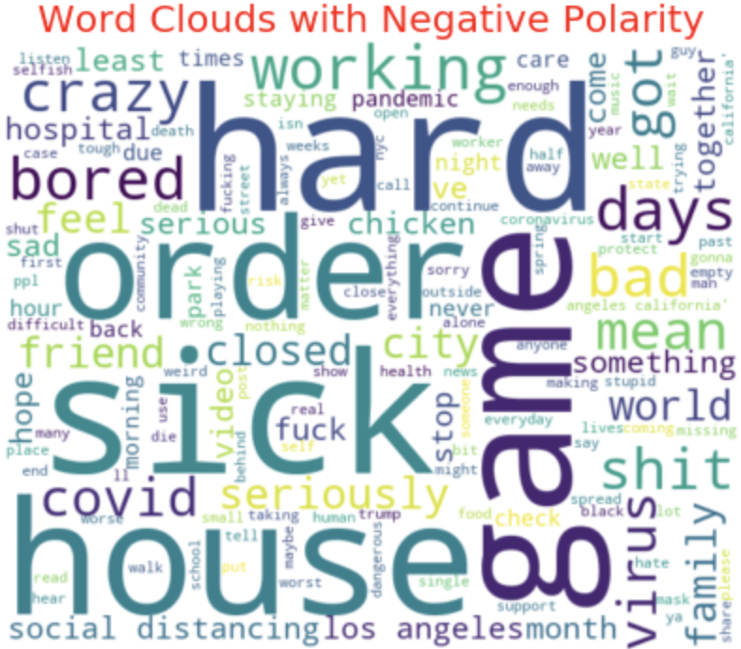
WORDCLOUD
Notes:
After dividing the tweets into positive, negative, and neutral categories based on polarity, we calculated the word frequencies for positive tweets and negative tweets separately, and drew a word cloud for each of the two categories.
From the first word cloud, we can see that positive tweets often contain positive words like “safe”, “great”, “happy”. There are also words like “video”, “music” that imply positive activities.
From the second word cloud, we can infer that negative tweets are mainly expressing worries about being sick, or complaining about being bored after staying at home for a long time.

Slide 9


TOPIC MODELING
Millions of Tweets
30 Topics
13 Topics
friend/family/grateful/neighbor
read/weekend/exercise/book
love/prayer/hand/wash
watch/video/share/youtube
free/food/donate
good/feel/world/moment/photo
word/message/picture
play/happy/music/game
challenge/workout/fresh/air
food/eat/house/clean
amazing/dinner/cook
show/favorite/movie
order/call/online/delivery
beautiful/smile/pretty/staff
Topic Modeling
time/remember/week/ago
Select Topics Related to Activities
friend/neighbor/family/grateful
LDA Mallet
mask/face/wear
…...
Notes:
Topic Modeling
We first tried out different number of topics to do topic modeling and used coherence value to choose the perfect number of topics. We decided that 30 topics are suitable for all the tweets data we have. Then we use keywords, which was the common words in each topic, to select related activities. There are 13 related activities derived from these 30 topics.

Slide 10
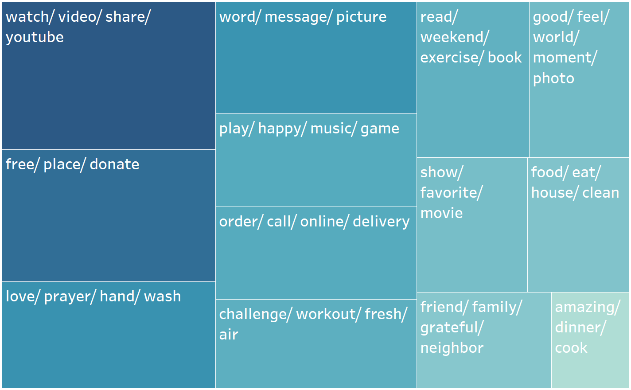
TOPIC MODELING
Notes:
This treemap shows the 13 activity-related topics we chose. The larger the rectangle and the darker the color, the more positive the topic.
Among these topics, watch videos (youtube) brings the most positive emotions. All these activities are related to relatively positive tweets. We can see from this result that paying attention to all kinds of activities instead of only focusing on confirmed cases numbers can make people feel more positive. So we encourage people to do more activities, such as watch videos, play games or do prayers, which can probably lead to a better sentiment on Twitter.

Slide 11
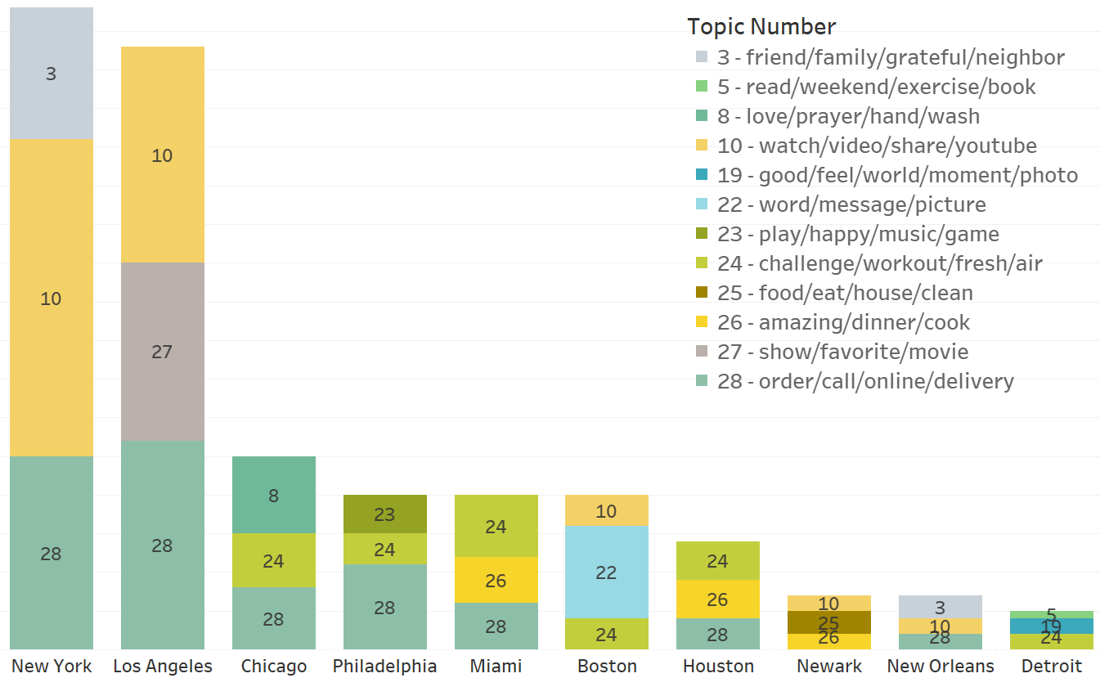
TOPIC MODELING
Notes:
Among the 15 topics, we chose top 3 for each of the ten cities based on the number of tweets related to the topic. For example, the three most popular positive topics in New York tweets are “3 - friend/family/grateful/neighbor”, “10 - watch/video/share/youtube”, “28 - order/call/online/delivery”. And Topic #28 is the most widespread one, ranking top three in 7 out of 10 cities.
Using this analysis result, we can understand people’s preferences in different cities and make targeted suggestions.

Slide 12
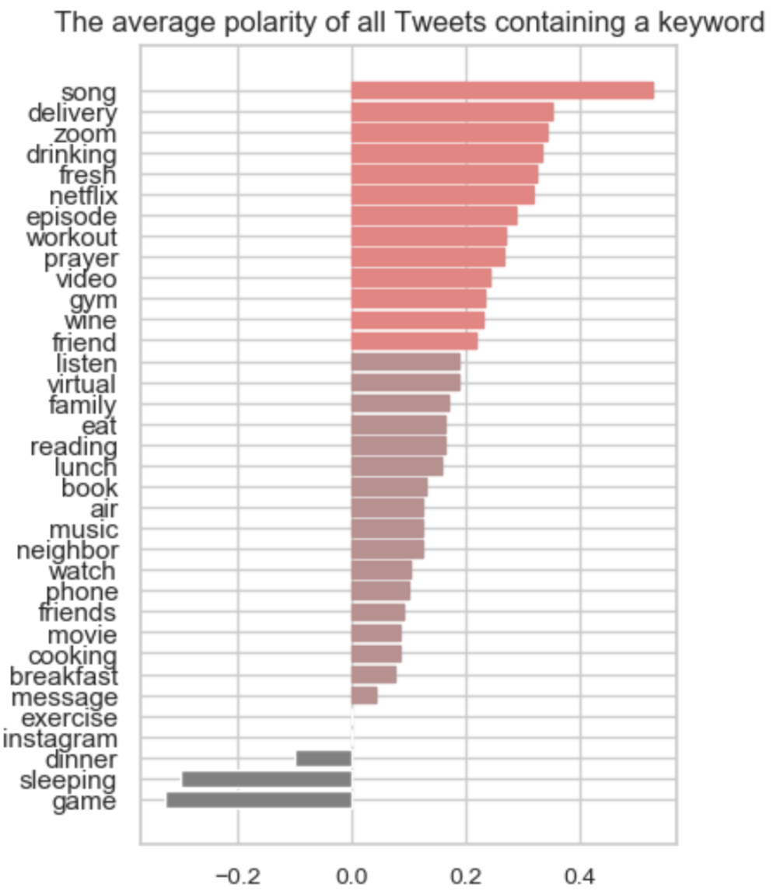
Words that have strong positive sentiments
delivery
song
netflix
drinking
video
wine
episode
zoom
friend
gym
prayer
Notes:
After finding the topics that have a strong correlation with people’s sentiment, we want to know more about what specific words have influenced people’s feeling. So we picked a list of high-frequency words from these topics and calculated the average polarity of all Tweets containing each word. We assume that if the average polarity of Tweets containing a word is very high, this activity has a positive relationship with people’s emotion.
Based on our analysis, we find that several activities have a very strong positive relationship with people’s emotions:
First, singing or listening songs help people to keep a good mood. Second, ordering food online also helps. Third, communicate with friends and family virtually helps releasing negative feelings caused by social distancing. Forth, watching videos, TV series (“episode”), and use Netflix have a positive effect on people’s emotion. Fifth, drinking sometimes helps people to feel better. Plus, activities including doing exercise and making a pray will boost one’s morale.

Slide 13






SUGGESTIONS
Music: Listen to songs or sing songs
Videos: Watch movies or TV series on YouTube and Netflix
Connection: Virtually connect with others with messages, phone, or video talks
Workout: Do a regular workout and breath fresh air
Reading: Read books that you are interested in
Kindness: Share free food or donate money
Prayer: Say a prayer
Labor: Do cleaning and cook by yourself
Notes:
Here are our suggestions based on the analysis result.

Slide 14
Thank you!

